Slide 1
Treasury Management
Working Capital/Liquidity Management

Slide 2
Outline
Definition of working capital
Working capital policy
Cash operating cycle
Debtor Management
Factoring
Invoice discounting

Slide 3
Defining Working Capital
Working capital is technically defined as current assets less current liabilities
Corresponds to cash and liquid assets that can quickly be converted to cash
There is a limited and fluctuating amount of cash and liquid assets available at any given time
Treasury’s responsibility is to manage and use pool of resources as efficiently and effectively as possible.

Slide 4
Defining Working Capital
If current assets exceed current liabilities (inventory plus debtors less creditors) the company has a cash surplus (usually represented by bank deposits and investments)
Otherwise it has a deficit (usually represented by a bank loan and/or overdraft)
A business must be able to generate sufficient cash to be able to meet its immediate obligations and continue trading

Slide 5
Defining Working Capital
Even a profitable business will go under if it does not have adequate liquid resources (the adage ‘cash is king!’)
Working capital is essential to the company’s long term success
The efficient management of working capital is important from point of view of both liquidity and profitability

Slide 6
Defining Working Capital
Poor management of working capital means that funds are unnecessarily tied up in idle assets, hence reducing liquidity and also reducing the ability to invest in productive assets such as plant and machinery

Slide 7
Working Capital Policy
Company’s working capital policy function of two decisions:
The Investment decision
In conditions of uncertainity, firms must hold some minimal level of cash and inventories based on expected sales, plus additional safety stocks

Slide 8
Working Capital Policy
With an aggressive working capital policy, firm would hold minimal safety stock
Such policy minimises costs, but lowers sales because firm not able to respond rapidly to increases in demand
conservative working capital policy, would call for large safety stocks
Expected return is lower under conservative policy, but so are the risks and vice versa.

Slide 9
Working Capital Policy
Moderate policy falls somewhere between the two extremes.
ii. The financing decision
Involve the determination of the mix of long term versus short term debt
Aggressive financing policy, firm finances part of its permanent asset base with short term debt

Slide 10
Working Capital Policy
Policy generally provides highest expected return ( because short term debt costs are typically less than long term debt), but it is very risky.
Conservative is less risky but also results in the lowest expected return
Maturity matching policy falls between the two extremes

Slide 11
The Operating Cycle
The length of time between company’s outlay on raw materials, wages and other expenditures, and the inflow of cash from the sale of the goods.
In manufacturing, this is the average time that raw materials remain in inventory, less the period of credit taken from suppliers, plus time taken for producing the goods, plus time taken by customers to pay for the goods.
Also called cash conversion cycle

Slide 12
Cash conversion cycle

Slide 13
Cash conversion cycle
This is an important concept for the management of cash or working capital because the longer the operating cycle the more financial resources the company needs.
Management needs to watch that this cycle does not become too long
If the company is deliberately building up its stock, this will lengthen the operating cycle

Slide 14
Calculating the cash conversion cycle
The Formula for CCC is:
Cash Conversion Cycle = Days’ inventory + Days’ receivables – Days’ payables
CCC is the average number of days between the cash outflow for the acquisition of materials and supplies, and the cash inflow from the sale of products or services.

Slide 15
Working Capital Matrix
Annual Revenues | K15,000
Annual Cost of Goods Sold | K9,200
Cash Flow from Operations | K550
Ending Inventory | K2,600
Ending Accounts Receivable | K1,700
Ending Accounts Payable | K1,600

Slide 16
Working Capital Matrix
Days’ Sales in Inventory or Days Inventory
Calculated as a function of the inventory value and the cost of goods sold.
Idea is to determine how many days it normally takes to convert inventory into actual sales during the period (e.g. one year)
Days inventory = Inventory x 365 = K2,600 x 365 = 103.15
Cost of Goods sold K9,200

Slide 17
Working Capital Matrix
B. Days’ Receivable (DR)
Calculated by determining how many days of sales reside in A/R.
Period ending value for A/R is divided by the amount of sales (or revenues) per day
DR represents the number of days required to convert a sale into a cash inflow

Slide 18
Working Capital Matrix
Days’ Receivables= Accounts Receivable x 365
Revenues
= K1,700 x 365 = 41.37 days
K15,000

Slide 19
Working Capital Matrix
C. Days’ Payables (DP)
Calculated by dividing A/P by the COGS per day
Days’ Payable = Accounts Payable x 365
Cost of Goods Sold
= K1,600 x 365 = 63.48 days
K9,200

Slide 20
Working Capital Matrix
D. Cash Conversion Cycle (CCC)
CCC the average number of days that elapse from the time the firm pays for inputs into the production-sales cycle to the time when cash is received from a sale
Cash Conversion Cycle = Days’ inventory + Days’ receivable – Days’ Payables
= 103.15 days + 41.37 days – 63.48 days = 81.04 days

Slide 21
Working Capital Matrix
On average during the prior year, 81.04 days elapsed from the time the company disbursed cash until it recovered cash from a sale
E. Cash Turnover
Number of cash cycles a firm experiences in one year
Cash Turnover = 365 = 365 = 4.5
Cash Conversion Cycle 81.04

Slide 22
Steps to Shorten the Operating Cycle
Number of steps can be taken to shorten the cycle:
The volume of debtor balances could be cut by quicker collection of debt
Finished goods could be turned over more rapidly
The level of raw material inventory could be reduced
Production period could be shortened

Slide 23
Debtor Management
In order to reduce debtor days to more sustainable level, companies will offer customers inducements in the form of cash discounts
These discounts may speed up collection but reduce amount from each sale when collected
Credit management involves balancing benefits to be gained from extending credit to customers against the costs of doing so

Slide 24
Debtor Management
Finding the optimum level of credit and discounts which will maximise the company’s profits.
also involves:
assessing credit risk of customers wanting credit
Collecting debts which are overdue
Assessing what effect changing credit terms will have on occurrence of bad debts
Setting individual credit limits for customers

Slide 25
Cost to a Buyer of Not Taking Cash Discount
Cash or trade discounts are offered to induce payment near the beginning of the credit term
Credit terms often are expressed in the form 2/10 net 30
This means the credit period or term is 30 days, but the customer may take a 2% discount if it pays the invoice within 10 days
If the customer pays any time from day 11 through day 30, then the full invoice amount is due

Slide 26
Example: cost of Cash Discount
Assume an organisation is offered credit terms 2/10 net 30
If organisation’s opportunity cost of funds is 8% (assuming this is its short term borrowing rate)
Should it take the discount?

Slide 27
Example: cost of Cash Discount
If the invoice is K100, then the customer can pay within 10 days and take a 2%, or K2.00 discount
The buyers resulting invoice is K98, with an option to finance the invoice for an additional 20 days (i.e. from day 11 to day 30) at a cost of K2.
If the buyer chooses to pay K100 on day 30, then it has charged itself K2.00 in interest to finance the invoice for 20 days

Slide 28
Example: cost of Cash Discount
The approximate annual cost of not taking the discount and paying at term is as follows:
Discount Cost = D x 365
100- D N-T
Where: D= Discount percentage
N= Net period
T= Discount period

Slide 29
Example: cost of Cash Discount
Discount cost = 2 x 365
100-2 30-10
0.0204 x 18.25 = 0.3723 or 37.23
The cost of not taking the discount can be compared with the organization's 8% opportunity cost to borrow short term funds.
Since the cost to borrow is less than the cost of not taking the discount, the customer should borrow funds and take the discount

Slide 30
Reasons for foregoing discount
If the organisation can earn a return exceeding the discount rate by investing funds in the short term instead of paying early and earning the discount
If the organisation does not have cash available to take the discount, but has to borrow the necessary funds at an interest rate higher than the appropriate cost of not taking the discount

Slide 31
Reasons for foregoing discount
3. If the organization has the ability to effectively change the terms by stretching out its accounts payable (AP) terms.
By paying the net amount at a later date, the paying organization is effectively reducing the implied interest rate on the transaction.

Slide 32
Financial Impact to Seller of offering cash discount
Sellers offer cash discounts to induce their customer to pay before term or to be competitive.
The net benefit can be calculated because there is a cost, in the form of lower revenue per kwacha of sales

Slide 33
Example: Net benefit of offering cash discount
Assume that a seller has an opportunity cost of 8%, the average credit sale to the buyer is K100, and the credit terms are 2/10 net 30.
To determine the present value (PV) of receiving the discounted payment on day 10, begin by calculating the discounted payment amount as follows:
PV = FV/(1+r)

Slide 34
Example: Net benefit of offering cash discount
And the interest rate (i) for the discounted period can be calculated as:
i= days in discount period x annual interest/365
= 10 x 8%/365 = 0.22%
The two can be combined to calculate the PV of the discounted payment as:

Slide 35
Example: Net benefit of offering cash discount
Pv_{day 10} = K98/(1+0.22%)= K97.78
Alternatively the PV of receiving the full payment after 30 days is calculated as:
Pv_{day} ₃₀ = K100/(1+0.66%) = K99.34
The seller can now calculate the NPV of the discount as follows:
NPV= PV_{day10} – PV_{day30}= K97.76-K99.34 = -K1.56

Slide 36
Example: Net benefit of offering cash discount
From results, the seller knows its net disadvantage is K1.56 for every K100 of credit sales if the buyer takes the discount and pays by day 10 rather than wait to pay the full amount on day 30.

Slide 37
Credit Control
To have good credit management you should assess the credit risk of your customer base
This would involve giving consideration to the credit control procedures
Key elements of credit control policy:
Terms of trade, notably the period of credit to be granted, and any discounts to be allowed for early settlement

Slide 38
Credit Control
b. On a customer-by-customer basis, it is necessary to assess creditworthiness and to establish limits in terms of amount and time

Slide 39
Sources of customer credit standing
Bank references- most banks in Zambia offer references on their customers
Trade references- suppliers already giving credit to the customer can give useful information about how good a customer is on baying bills
Published information – customer’s annual accounts and reports will give some idea of general financial position of company and its liquidity

Slide 40
Sources of customer credit standing
iv. Credit agencies- agencies such as the Credit Reference Bureau in Zambia keeps information of individual and company borrowings from different banks
v. Company’s own sales record- for an existing customer, the sales ledger will show how prompt a payer the company is

Slide 41
Chasing Overdue Accounts
There is need to have well defined procedures for following up overdue debts. In worst case scenario, there will be need to understand the law relating to contracts, insolvency, winding up and liquidation.
One can also sue for the debt or institute winding up proceedings.
In Zambia ‘the small claims court’ deals with non-payment of amounts owed by individuals and small firms

Slide 42
Factoring
Management may contract out the management of receivables
In many industries, the capital required to fund the granting of credit to customers represents substantial proportion of total sales
The greater the volume, the greater the investment in receivables.

Slide 43
Factoring
Rather than obtaining traditional finance (e.g. equity and overdrafts), some business outsource this process to concentrate only on the provision of goods or services
Specialist finance companies offer a factoring arrangement under which they:

Slide 44
Factoring
Provide finance by advancing, say, 80% of invoice value immediately, the remainder being settled when the customer settles the debt (net of finance charge, i.e. 3% per annum above base rate)
Take responsibility for the operation of the client’s sales ledger, including assessment of creditworthiness and dealing with customer’s for an additional fee, offer non-recourse finance, i.e. guarantee settlement even if they are not paid by the customer

Slide 45
Evaluation of Factoring Facility
Example
Mutengo Plc has been set up for the purpose of importing commodities which will be sold to a small number of reliable customers.
Sales invoices are forecast at K300,000 per month
The average credit period for this type of business is two and half months

Slide 46
Evaluation of Factoring Facility
The company is considering factoring its accounts receivables under a full factoring agreement without recourse.
Under the agreement, the factor will charge a fee of 2.5% on total invoices
He will give an advance of 85% of invoiced amounts at an interest rate of 13% per annum

Slide 47
Evaluation of Factoring Facility
The agreement should enable Mutengo PLC to avoid spending K95,000 on administration costs.
Required
Calculate the annual net cost of factoring;
Consider the financial benefits of such an arrangement, having regard to current interest rate on bank overdrafts of 12.5%

Slide 48
Solution
Annual sales: K300,000 x 12 = K3,600,000
Annual net cost of factoring:
Fee: 2.5% of K3,600,000 K90,000
Annual interest ( 2.5/12 x 3.6m x85% x 13%) +K82,873.67
K172,875
Less: administration costs - K95,000
Net costs K77,875

Slide 49
Solution
2. The borrowing of K637,500 i.e. (2.5/12 x 3.6m x 85%) from the bank would cost K79, 687.50
Therefore, factoring offers a saving of around K2,000

Slide 50
Advantages of Factoring
Flexibility – as sales increase with the corresponding demand for finance, so finance from this source increases
Security- it allows the firm to pledge other assets as security for the finance
Last resort- it may be the most cost effective lender to a firm which has no assets to offer as security

Slide 51
Advantages of Factoring
Iv. Responsibility- relieves management of the responsibility for the sales ledger and can probably perform credit checking better than the firm.

Slide 52
Disadvantages
Customer resistance
Customer relationship
Reputation
Too reliant

Slide 53
Invoice Discounting
Specialist finance company can alternatively discount the companies invoices
They provide the finance as above but do not get involved with the operation of the sales ledger or hence become known to the customers
It is cheaper than factoring and avoids creating a barrier between the business and its customer

Slide 54
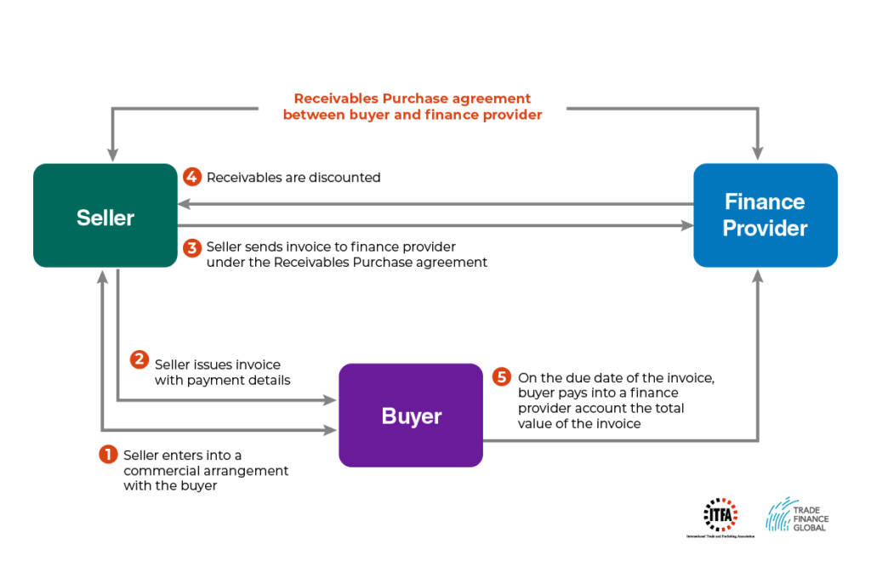
Invoice Discounting

Slide 55

Question?
What is the difference between factoring and invoice discounting?

